Slide 1
AI for Kids
Manal Helal and Luke Wook
June 2024

Slide 2
Outline
Please ensure you filled out your Questionnaires at the start and end of this activity.
The following will explain how AI works, its limitations and its ethical use.

Slide 3


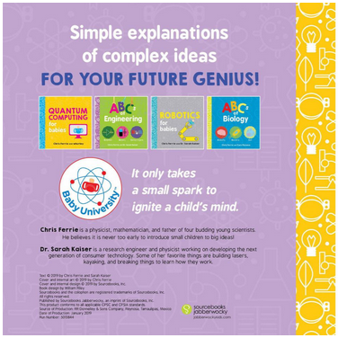
Artificial Neural Networks Behind AI latest advances
The book presented
From a nice series
Notes:
NOTE: To change images on this slide, select a picture and delete it. Then click the Insert Picture icon in the placeholder to insert your own image.

Slide 4
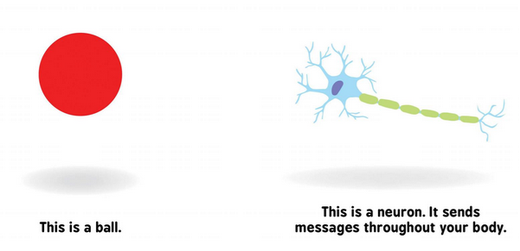
Your eye (sensor) passes to the brain what you see. This activates a neuron.
Notes:
NOTE: To change images on this slide, select a picture and delete it. Then click the Insert Picture icon in the placeholder to insert your own image.

Slide 5
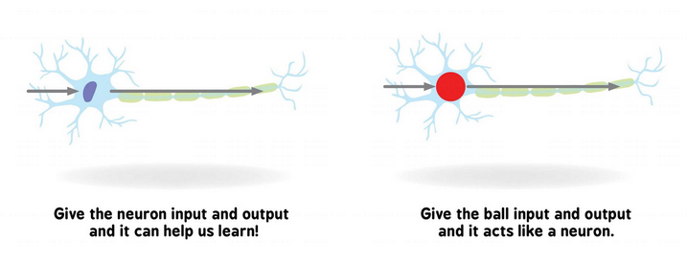
The neuron tries to understand and can activate another neuron (maybe a memory of other images you saw before) to learn the description of the image.

Slide 6
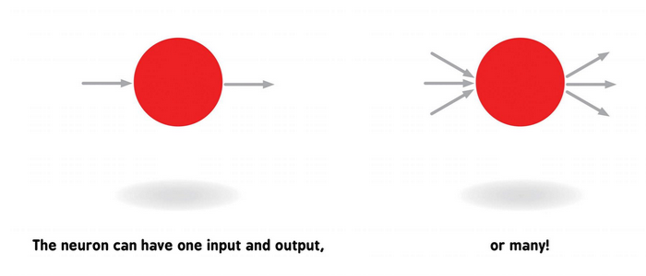
One neuron can be activated by one input or more. The neuron outputs one or more outputs to activate another one more neurons. Maybe you saw a lion and need to activate your legs to run out of there.

Slide 7
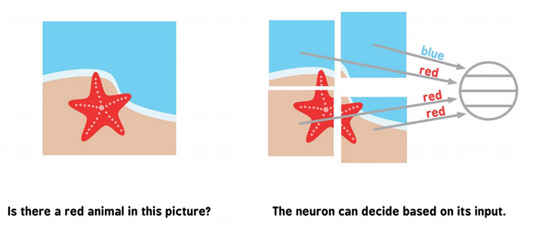
Trying to understand what you saw; your neurons divide any scene into partitions and label each

Slide 8
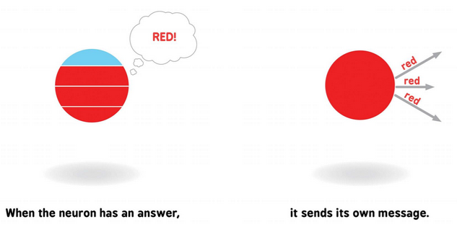
All labels/descriptions of the scene partitions in one neuron, decide its one or more outputs

Slide 9
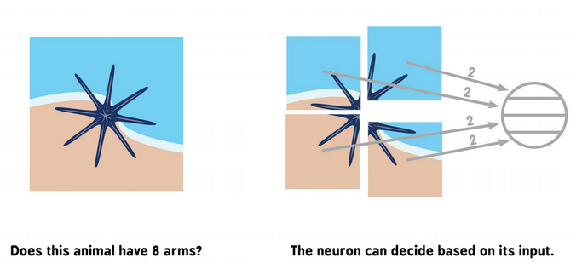
Weighting these inputs and outputs with your prior knowledge, your brain decide the scene contents

Slide 10
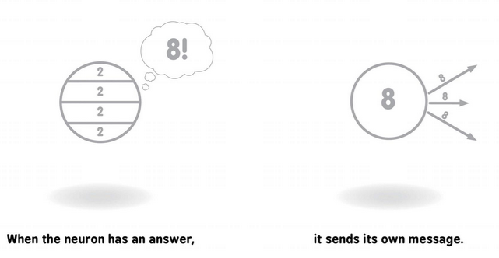
The answer from one neuron is sent to another neuron or more

Slide 11
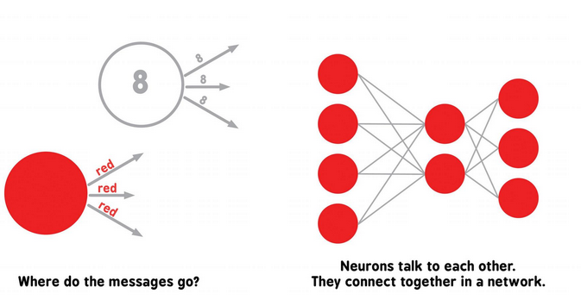
Many neurons talk to many neurons in your body to see, move, talk, learn and everything

Slide 12
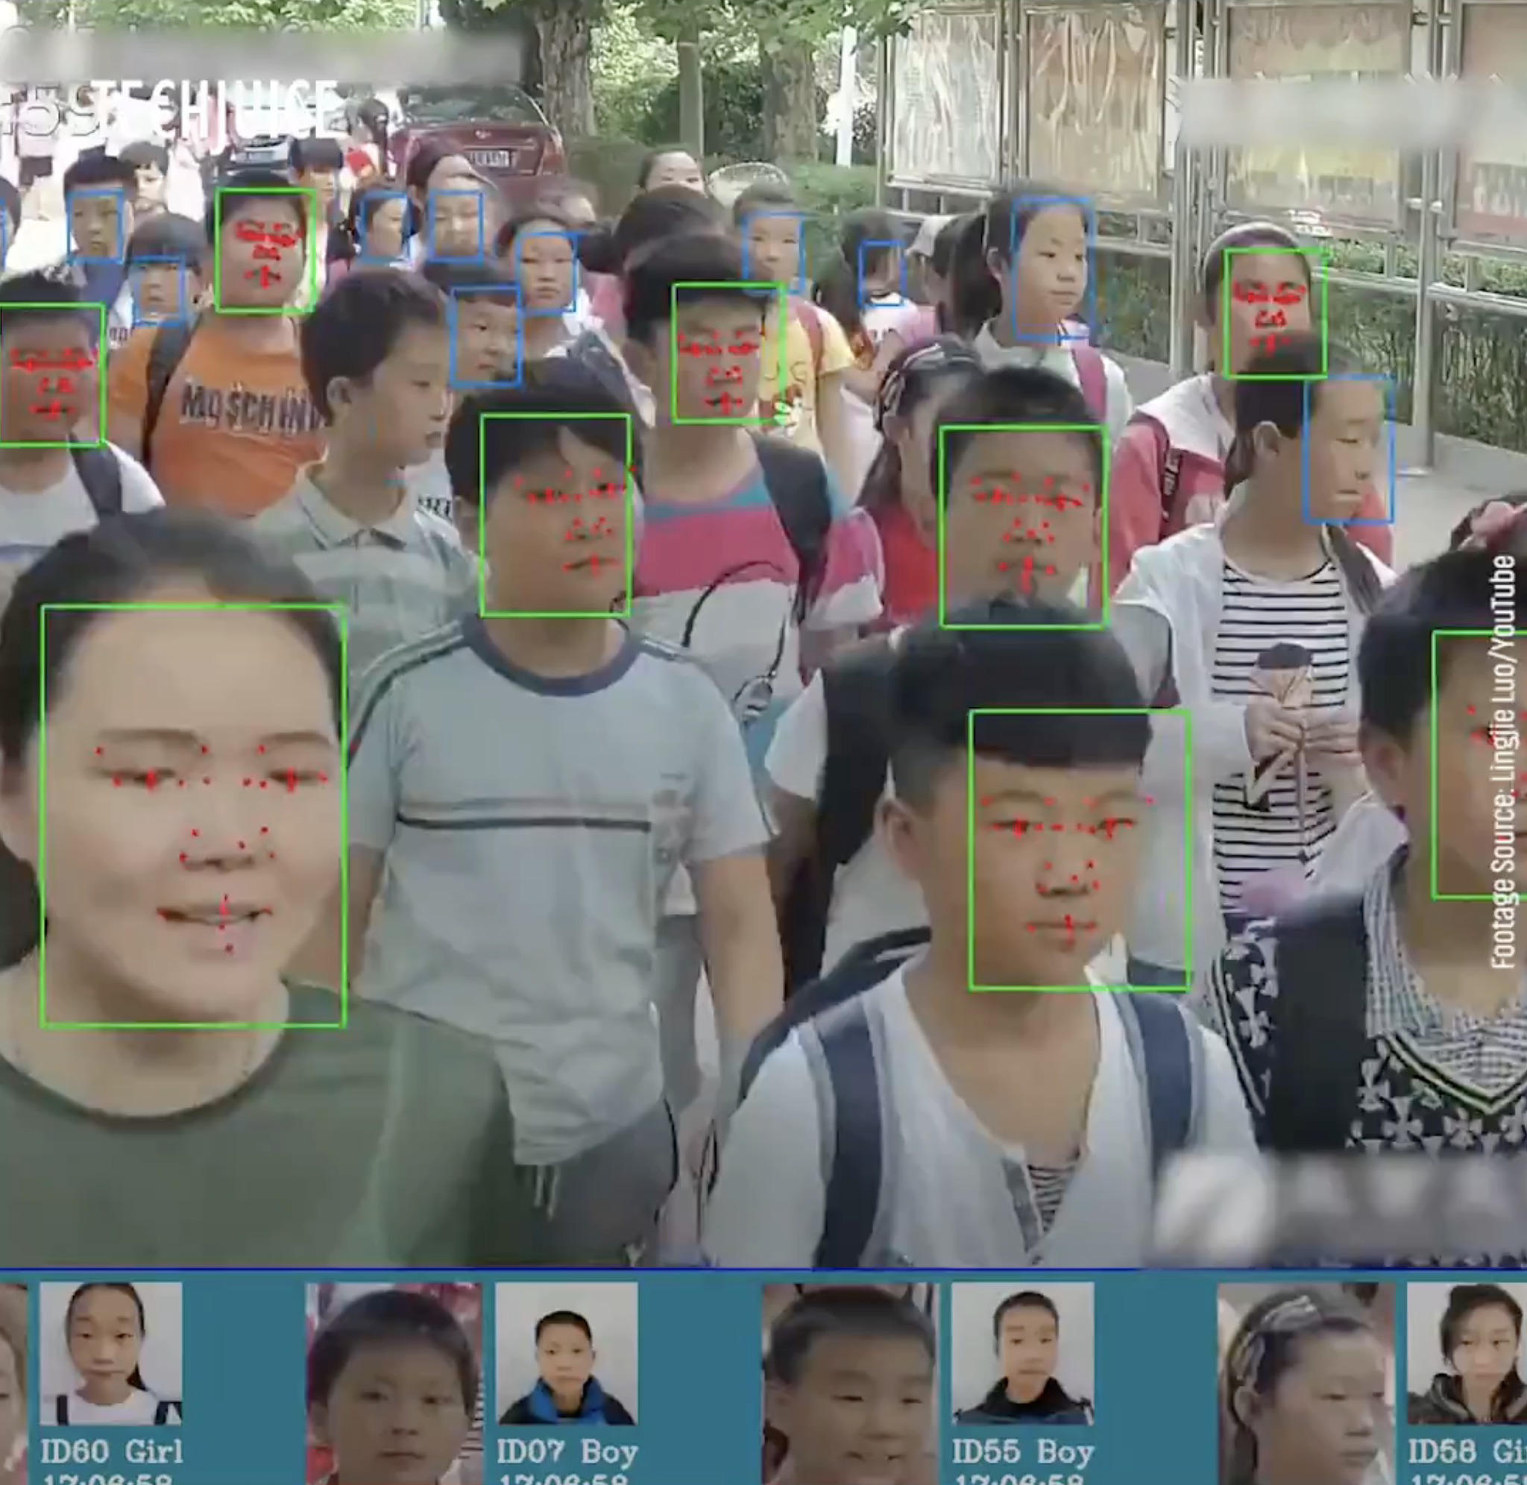
From 2013: Artificial Neural Networks (ANN) now remember people's faces and label them with their names, and many animals and objects around us.
Image credit: https://www.eecs.yorku.ca/~kosta/Courses/EECS6322/

Slide 13
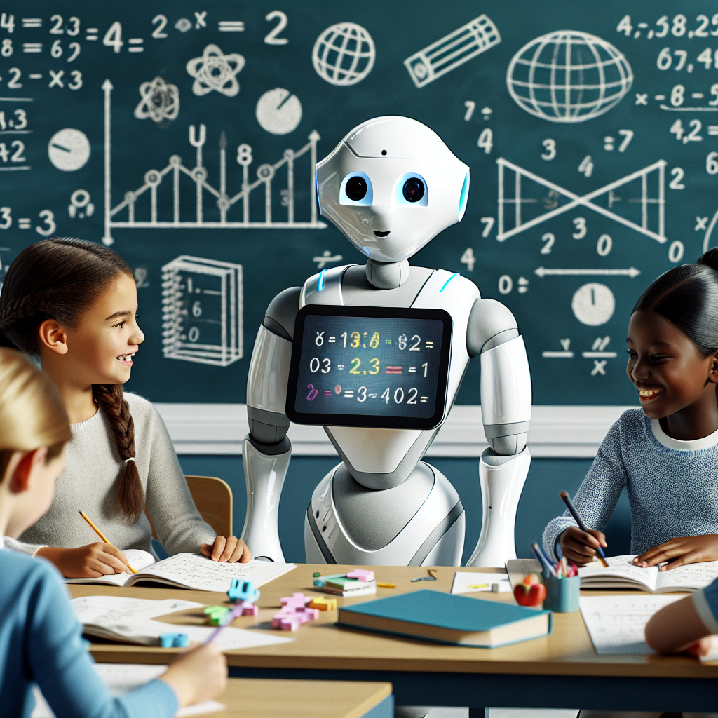
Computers are now trained on so many human faces that they can generate new faces that do not exist around us.

Slide 14

In 2016, computers learned how to play games and won against the Human World Champion and continue to do better in many games and tasks.
Image credit: https://www.eecs.yorku.ca/~kosta/Courses/EECS6322/

Slide 15
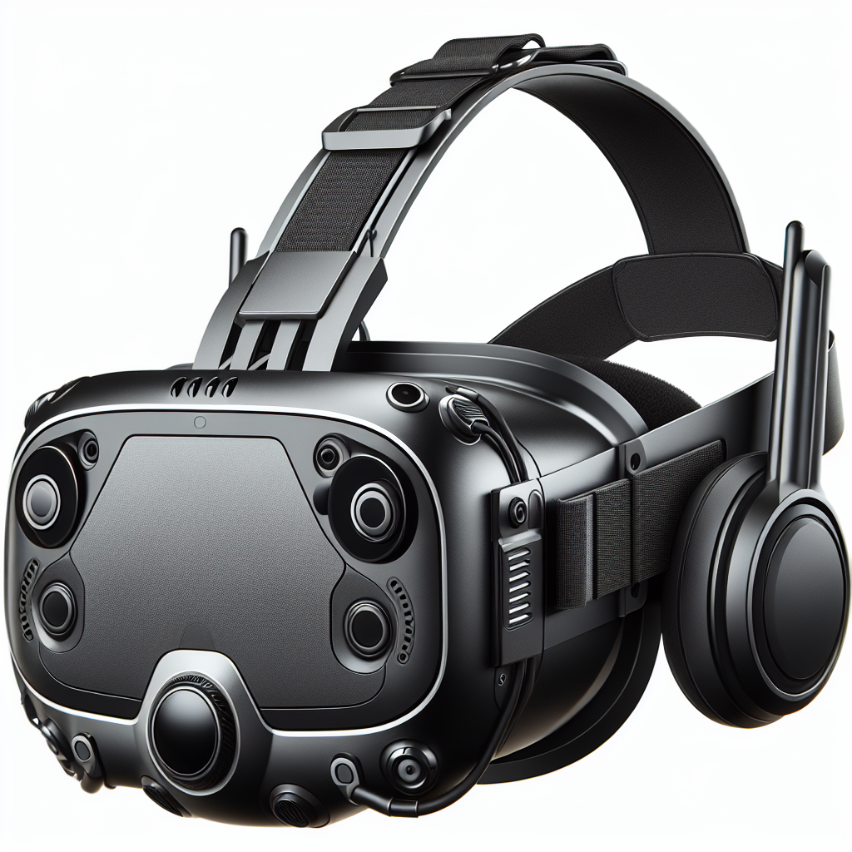
People can wear devices to see and remember things for them and, similarly, to hear from the different devices that assist them in knowing the labels and making decisions.

Slide 16
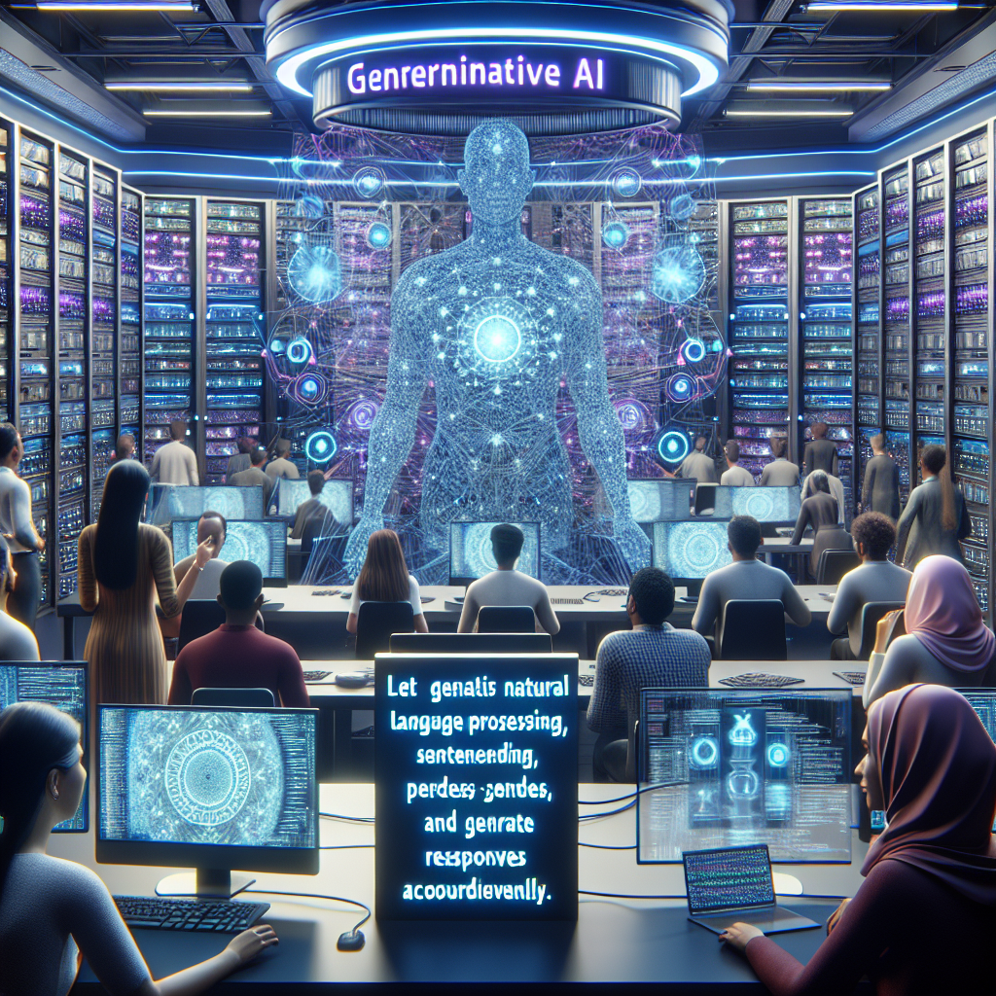
Computers learn so much text written in many books and on the internet that they can also generate new conversations with humans like humans can together.

Slide 17
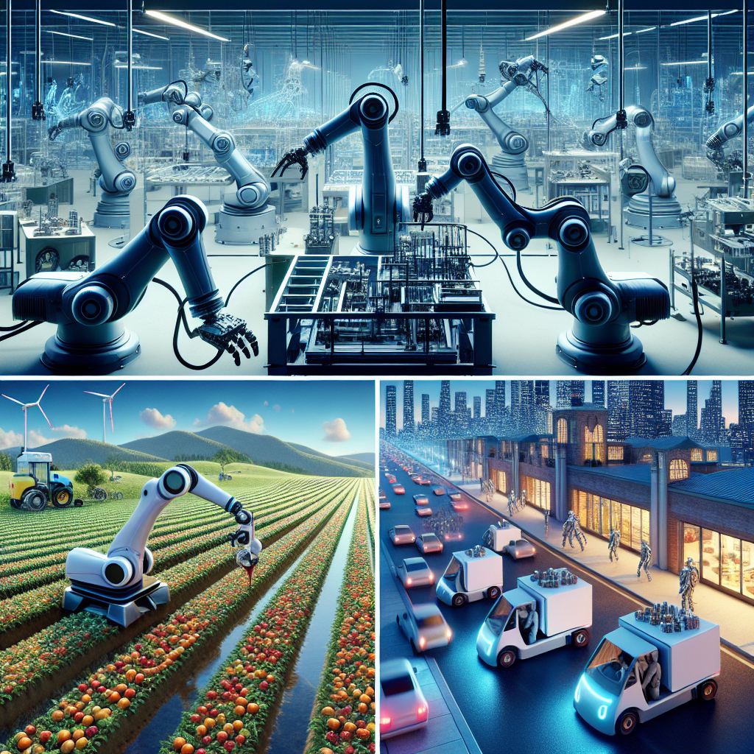
Many Jobs done by humans are now done by robots, particularly in manufacturing, farming, logistics and delivery

Slide 18
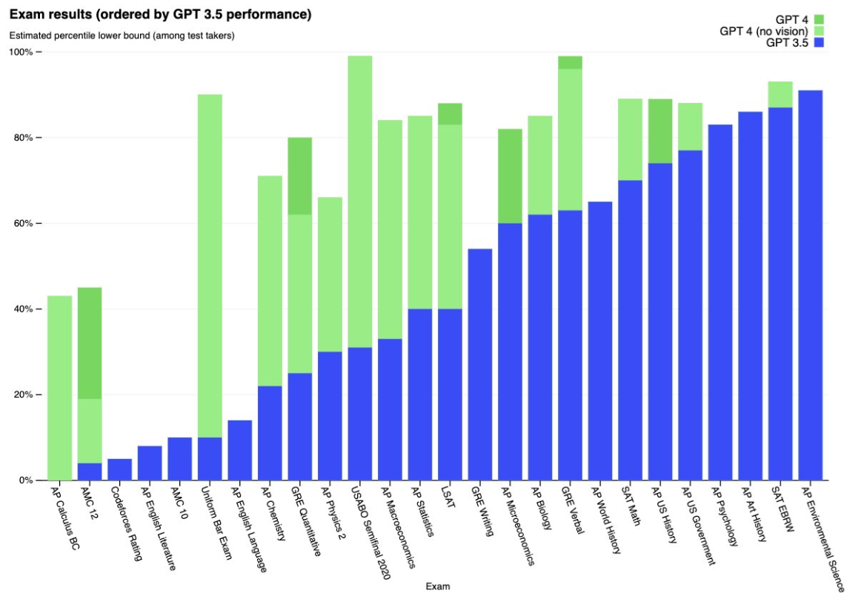
47% : 56% of all Job tasks can finish faster using AI
Job titles | AI Impact
Communications Manager | 98%
Data Collector / Entry | 95%
Chief Executive Officer (CEO) | 91%
Therapist | 90%
Delivery Driver | 88%
Typist | 80%
Job titles | AI Impact
Postdocs and Professors | 5%
Nurse | 5%
Technician | 5%
Singers and Artists | 5%
Private Tutor | 5%
Caregiver | 5%
Historian | 5%
Geographer | 5%
Stylist | 5%
65% of today’s children will be working in jobs not yet created.
N. Perucica, “Our children are growing up with AI:
what you need to know,” Jan. 2022. [Online]. Available: https://www.weforum.org/agenda/2022/01/artificial-intelligence-children-technology/
Eloundou, T., Manning, S., Mishkin, P., Rock, D.: GPTs are GPTs: An Early
Look at the Labor Market Impact Potential of Large Language Models. https:
//doi.org/10.48550/arXiv.2303.10130

Slide 19
Ethical and Legal concerns
Misinformation and Fake Content
Privacy and Data Protection
Bias and Discrimination
Intellectual Property
Security and Malicious Use
Regulation and Accountability

Slide 20
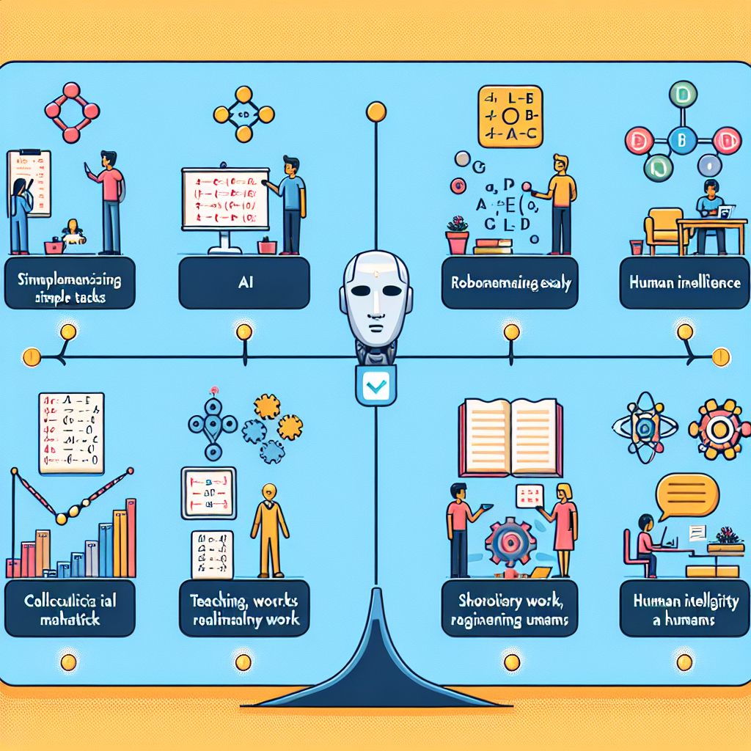
Observations: Simple Tasks and exams that require memorising lots of details are better done by AI and Robots. Complex tasks or human support tasks (teaching, scholarly and spiritual) are not impacted by AI in jobs, and calculus and reasoning exams are not passed easily by AI and need human intelligence.

Slide 21
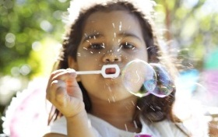
Thank you, we hope you enjoyed the day. Please fill out the questionnaires, Manal Helal Luke Wood
The Questionnaire
Notes:
NOTE: To change images on this slide, select a picture and delete it. Then click the Insert Picture icon in the placeholder to insert your own image.

Slide 22
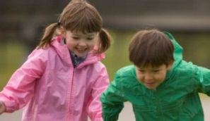
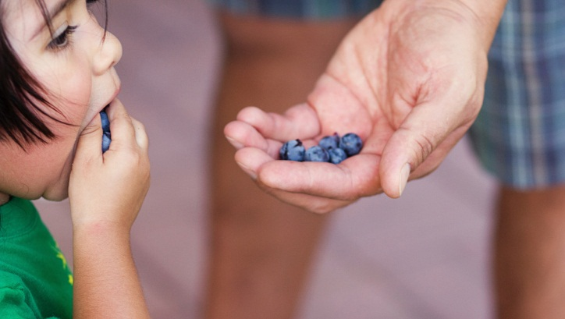
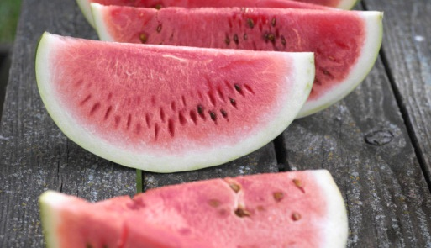
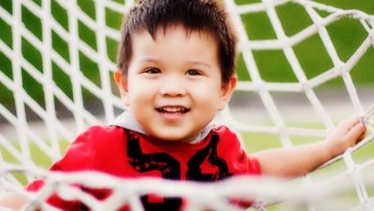
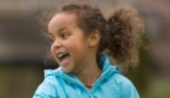
Five pictures
Notes:
NOTE: To change images on this slide, select a picture and delete it. Then click the Insert Picture icon in the placeholder to insert your own image.

